Slide 1


Bee local: A comparison of productivity and pathogen load in local vs. California re-queened colonies.
---
Andre Burnham, Fiona McLaughlin, P. Alexander Burnham & Herman Lehman

Slide 2
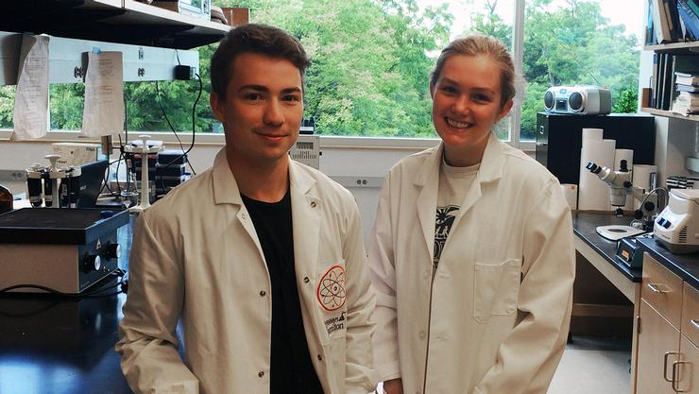
The Team

Slide 3
The question:
“Do locally-bred queens produce healthier, more productive colonies that are better adapted to their environment than imported queens?”

Slide 4

The basic premise behind this study
Mass Produced:
Hand-made:
VS.

Slide 5
The basic premise behind this study
Imported:
Local:
VS.

Slide 6
Experimental Design
20 colonies re-queened with Californian-bred queens
20 colonies re-queened local-bred (Vermont) queens
Sampled for pathogens and productivity measures
Sampled at different time points for 3 months

Slide 7
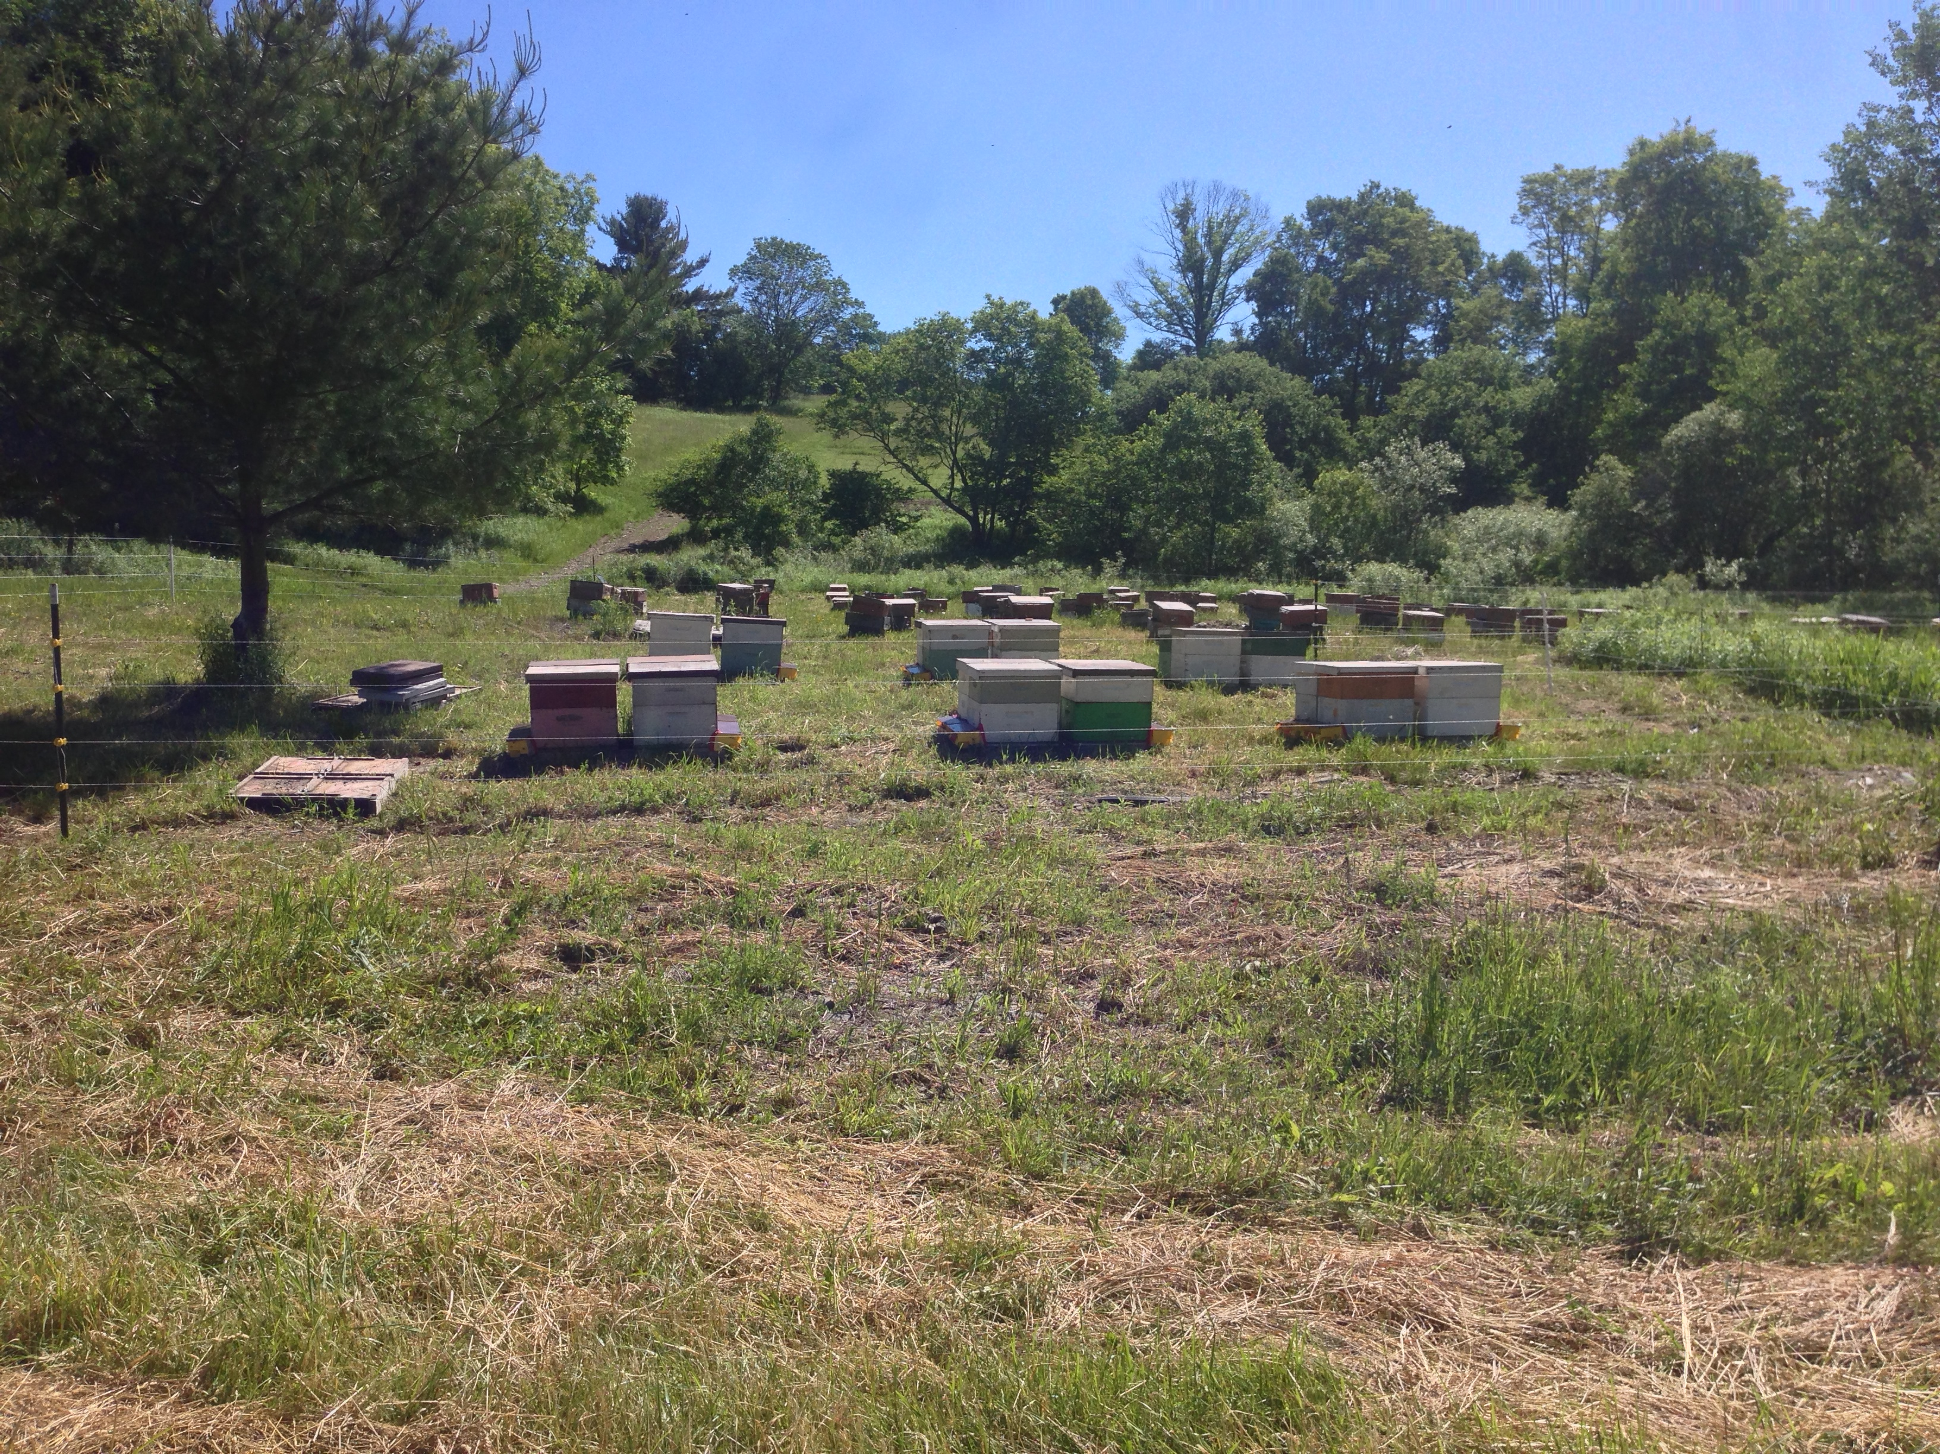
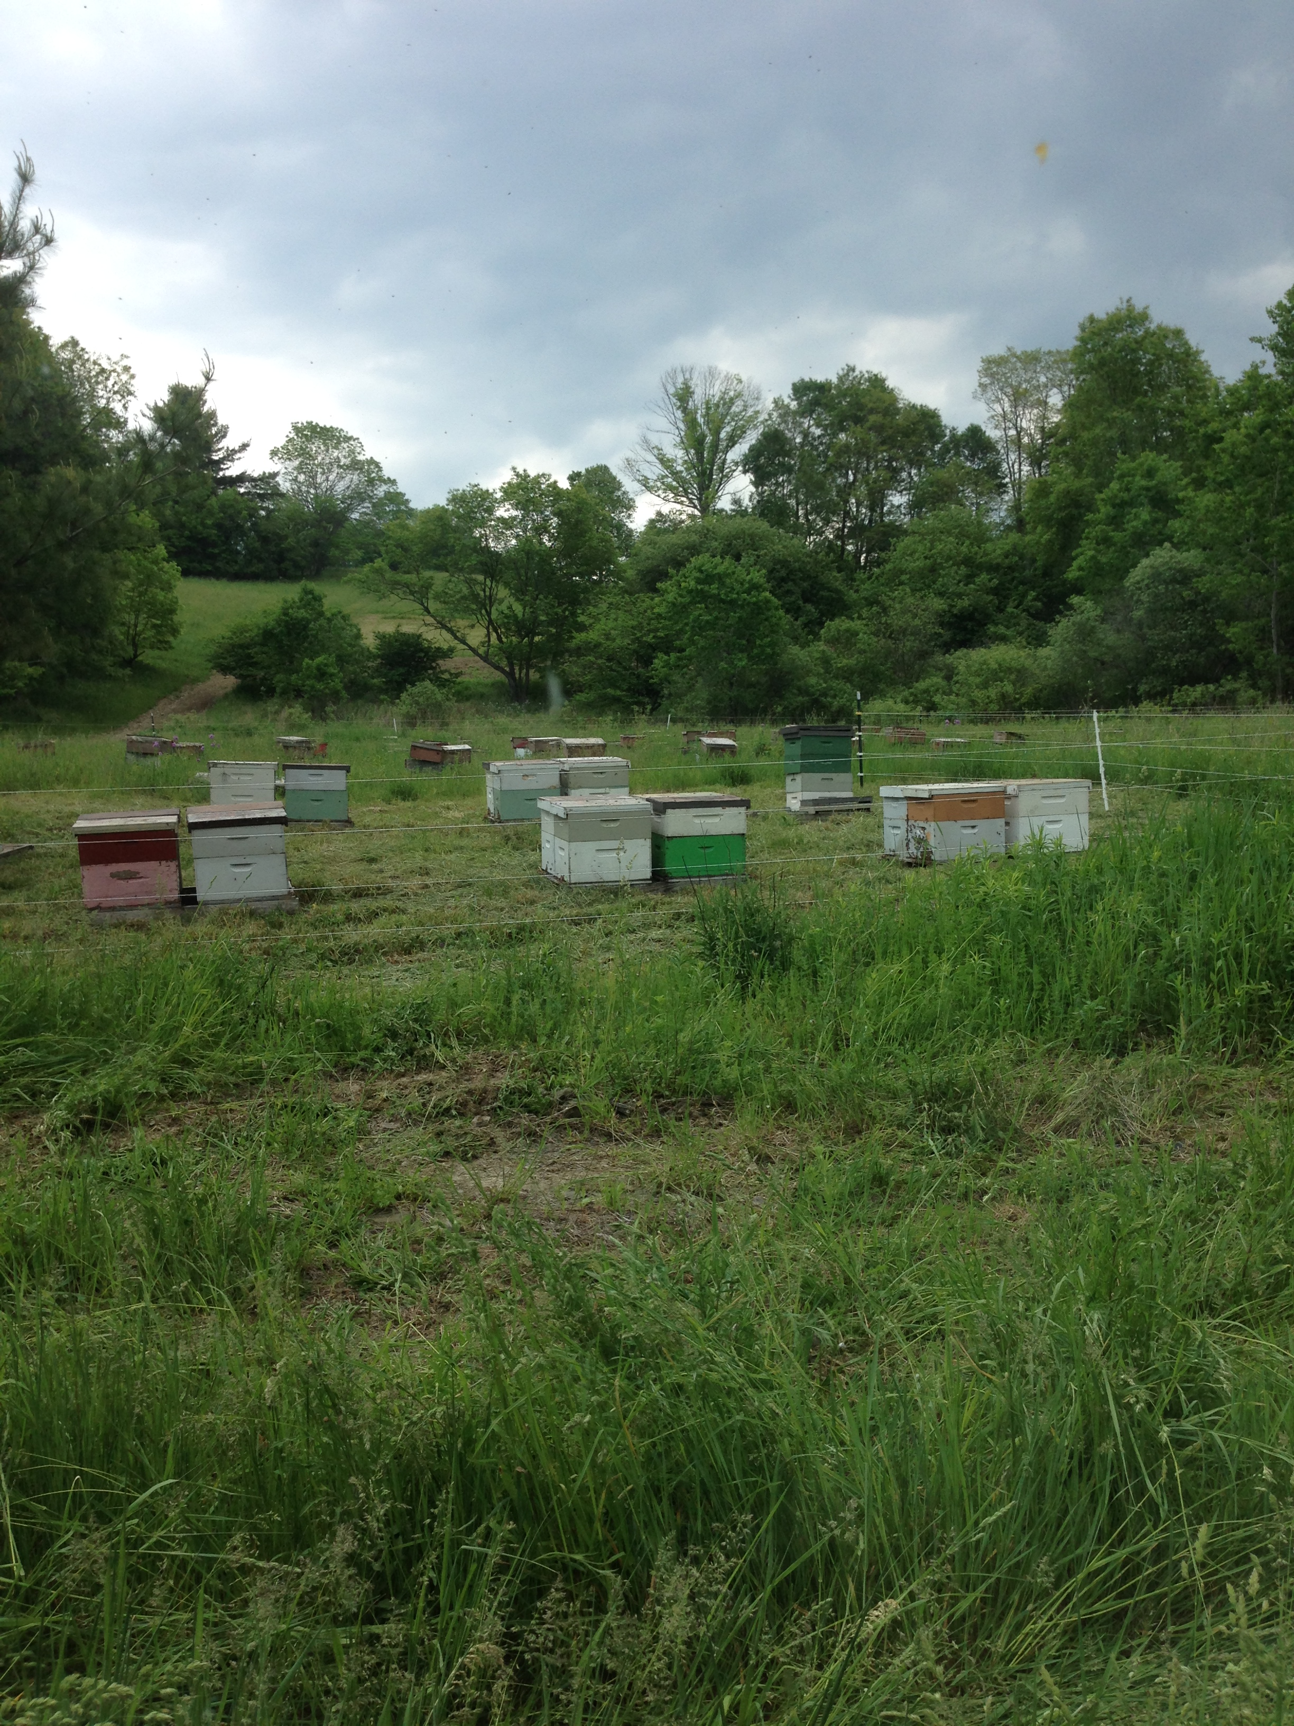
Pictures of the Yards

Slide 8
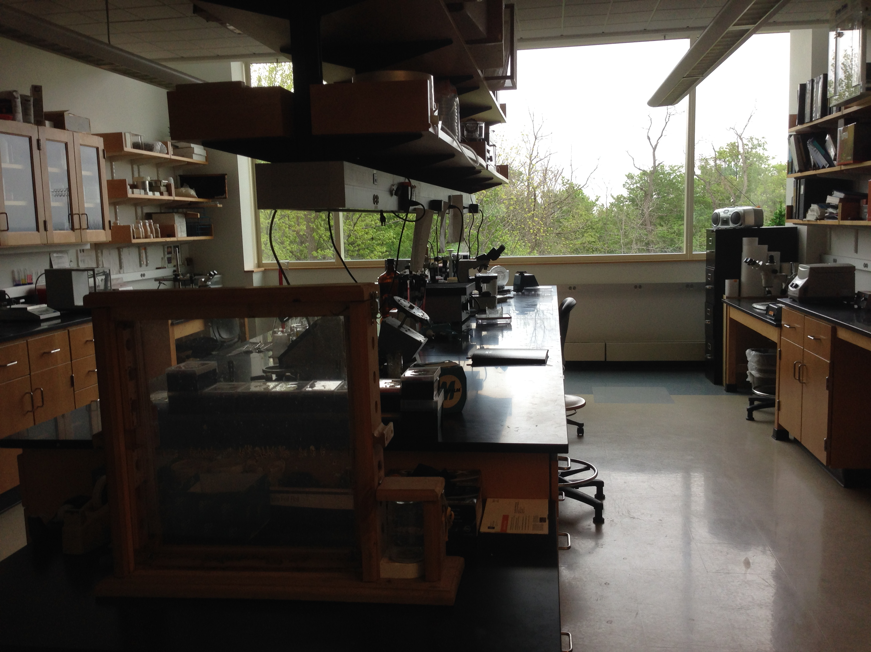
What did we sample for?
Growth:
Colony Mass
Brood Production
Foraging:
Pollen Production
Pathogens:
Varroa
Nosema spp.
RNA Viruses

Slide 9
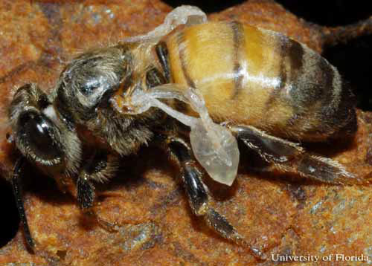
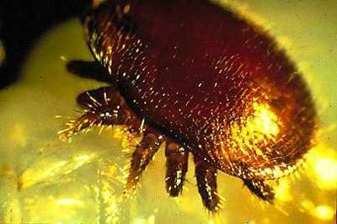
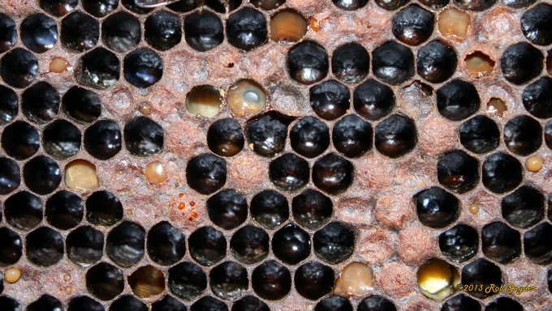
Honey Bee Pathogens:
VIRUSES:
Deformed Wing Virus (DWV)
Black Queen Cell Virus (BQCV)
Israeli Acute Paralysis Virus (IAPV)
PARASITES:
Nosema (ceranae & apis)
Varroa Mite
OTHER PATHOGENS & Pests:
American Foulbrood (AFB)
European Foulbrood (EFB)
Chalk Brood
Black shiny bee
Small Hive Beetle
Deformed wing Virus
University of Florida,
Entomology Dept.
Varroa destructor
North Carolina State University,
Cooperative Extension
American Foulbrood
Bee Informed Partnership

Slide 10
Our Hypotheses:
Local queens (colonies) will have better growth through the season
Local queens will be better foragers
Local queens (colonies) will have lower pathogen loads

Slide 11
Colony Mass (growth)

Slide 12
Frames of Brood (growth)

Slide 13
Pollen Collection (foraging)

Slide 14
Varroa Load (pathogens)

Slide 15
Nosema Load (pathogens)

Slide 16
Viral Load (pathogens)

Slide 17
In summary:
Overall, colonies re-queened with locally raised queens had higher growth
Some pathogens seemed to have less of an affect on local queens and others had similar affects across both groups

Slide 18
Implications:
Locally raised queens seem to be an overall better fit with the northern environment.
This could be evidence for the importance of care in breeding stocks (mass produced vs. handmade)
And/Or This could be evidence for local (genetic) adaptation (imported vs. local).

Slide 19


Acknowledgments
Authors:
Andre Burnham
Fiona McLaughlin
Herman Lehman
Thank you to…
The Casstevens Family
Nancy Thompson
Samantha Alger

Slide 20
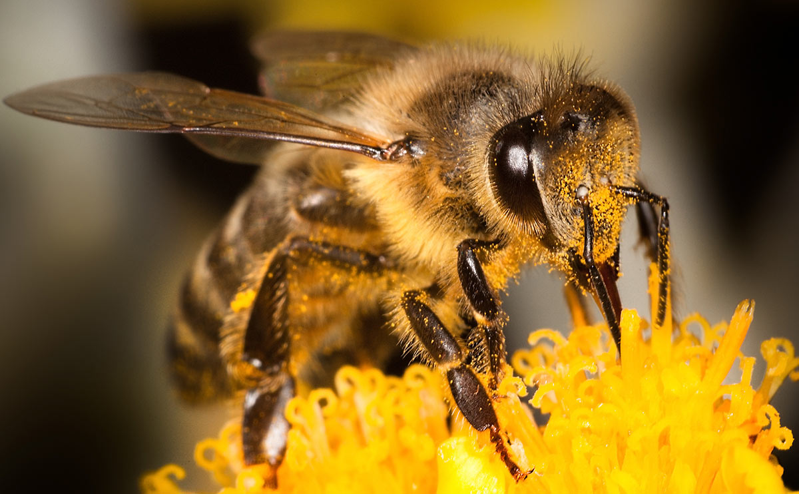
Thank You!

Slide 21
Questions?

